Slide 1
Image Classification Using CNN
On CIFAR10
XinYun Chen, Haimin Zhang
Ninad Gadre, Krutika Deshpande

Slide 2
CONTENTS
Objective
Dataset & Tool
Modeling & Algorithms
Results
Conclusion

Slide 3
Data Set & Tool
Xinyun Chen

Slide 4
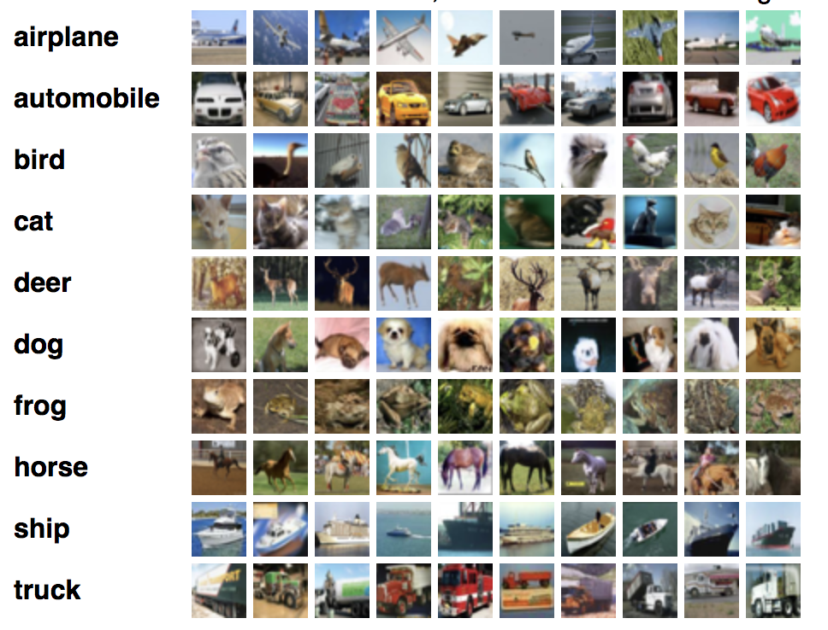
CIFAR 10
60000 32x32 color images
in 10 classes
5 training batches + 1 test batch each with 10000 images
test batch: 1000 randomly-selected images from each class training batches: 5000 images from each class

Slide 5
Data Processing
1
Reshape as (10000,3,32,32)
Transpose as (0,2,3,1)
2
Normalize pixel values
3
Floating point values
4
Store them in array
5
Concatenate into table in column order

Slide 6
CNN Model
Input tensor
[5, 32, 32, 3]
32 features
5x5 filter
ReLU activation
[5, 32, 32, 32]
64 features
5x5 filter
ReLU activation
[5, 16, 16, 64]
Flatten tensor
[5, 8 * 8 * 64]
0.6 probability
Fully
connected
Layer 1
Layer 2
conv 2
pool 2
dropout
conv 1
pool 1
max pooling
2x2 filter
stride of 2
[5, 16, 16, 32]
max pooling
2x2 filter
stride of 2
[5, 8, 8, 64]
1024 neurons
[batch_size, 8 * 8 * 64]
[batch_size, 1024]

Slide 7
Results
Batch Size : 128
Steps: 2000
5 * 5 kernel size
3 * 3 kernel size
accuracy: 0.4516
loss: 1.5138574
accuracy: 0.6297
loss: 1.0620928

Slide 8
关键技术与实践难点
关键技术
实践难点
市场调研分析
案例对比分析

Slide 9
THANK YOU FOR WATCHING

